Slide 1
Infrastructure

Slide 2
Components of Structured Cabling
ANSI/TIA-568 Commercial Building Wiring Standard
Also known as structured cabling
The wiring standard describes the best way to install networking media to maximise performance and minimise upkeep
The principles apply no matter what type of media, transmission technology, or networking speeds are involved
Structured cabling is based on a hierarchical design and assumes a network is based on the star topology

Slide 3
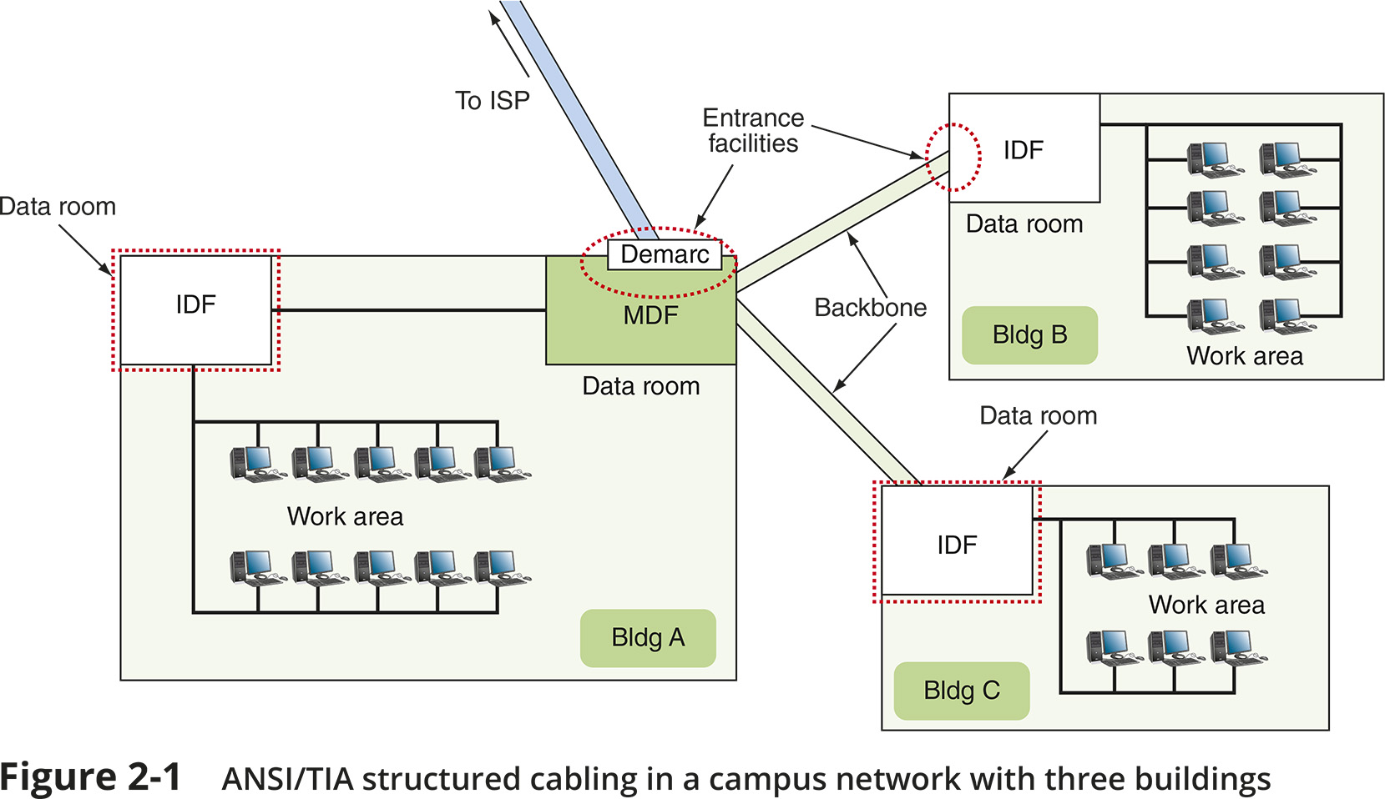
From the Demarc to a Workstation (1 of 11)

Slide 4
From the Demarc to a Workstation (2 of 11)
Entrance Facility in Building A:
EF (entrance facility) – location where the incoming network (such as Internet) connects with the school or corporate network
Demarc (demarcation point) – the device that marks where a telecommunications service provider’s network ends and the organisation’s network begins

Slide 5
From the Demarc to a Workstation (2 of 11)
Entrance Facility in Building A:
MDF (main distribution frame) – the centralised point of interconnection for an organisation’s LAN or WAN (also called MC or main cross connect)
Data room – an enclosed space that hold network equipment (also called data closet, data centre, equipment room, or telecommunications room)
Rack – holds various network equipment
Patch panel – a panel of data receptors which can be mounted to a wall or a rack
A patch panel provides a central termination point when many patch cables converge in a single location

Slide 6
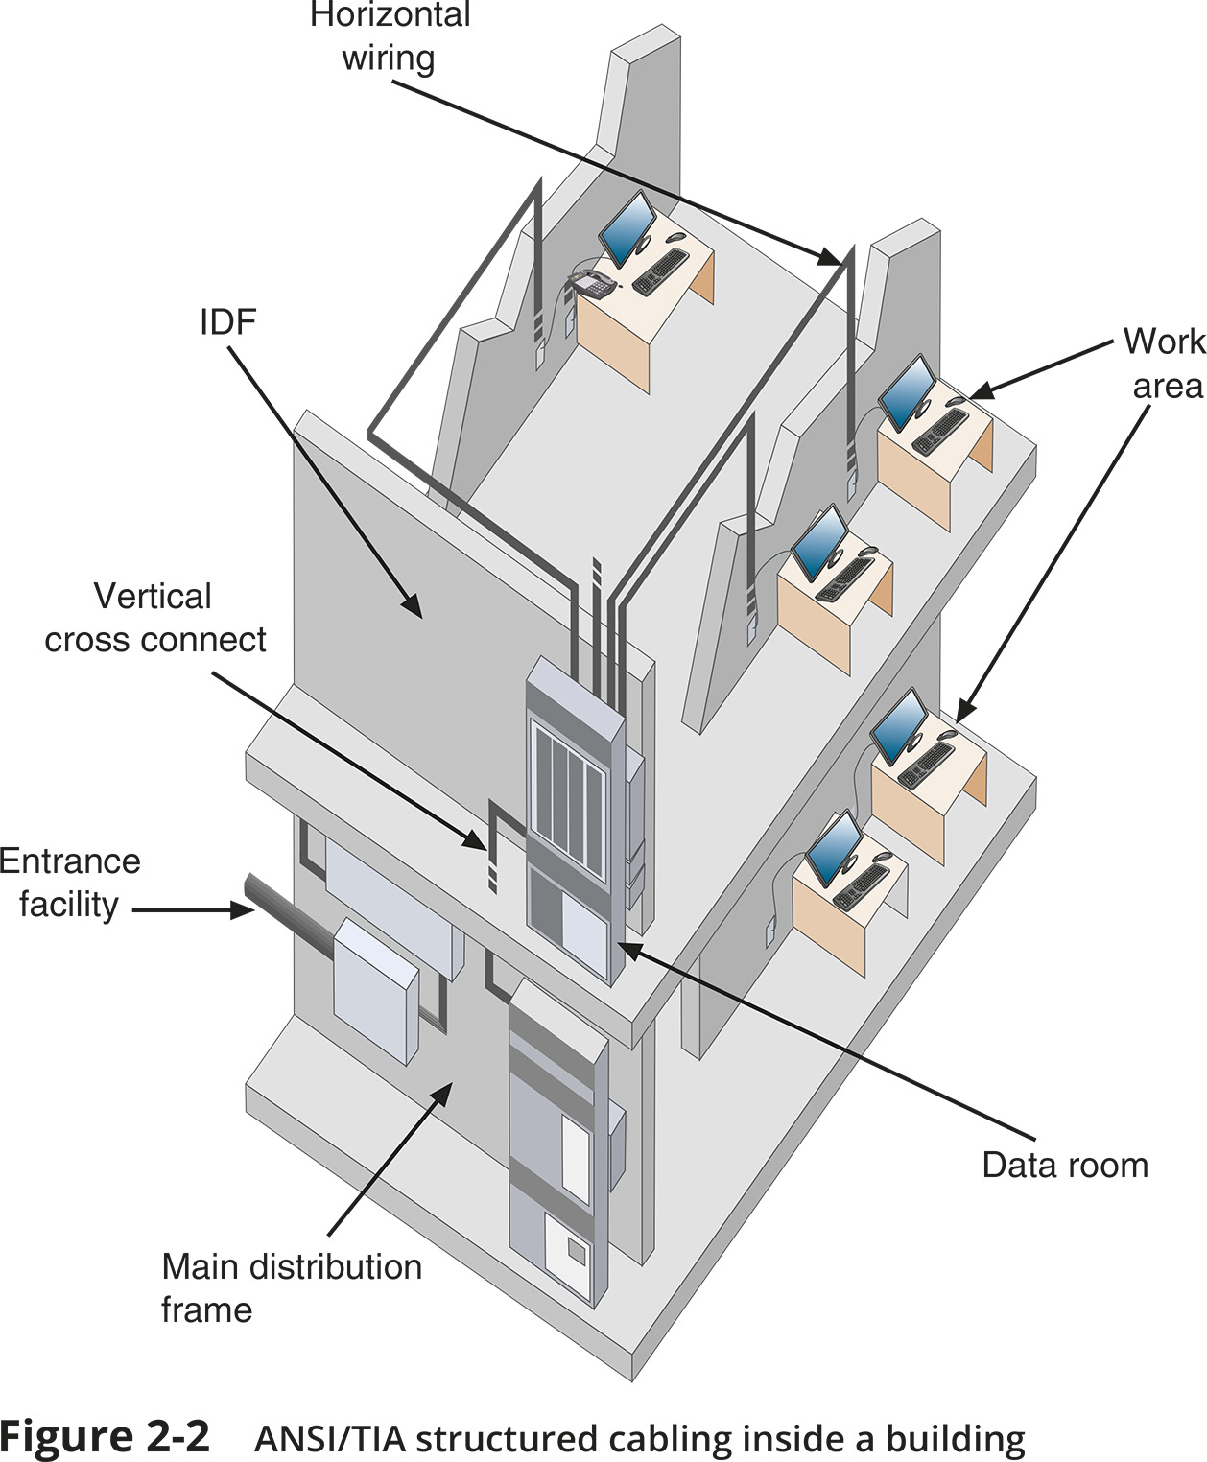
From the Demarc to a Workstation (3 of 11)

Slide 7
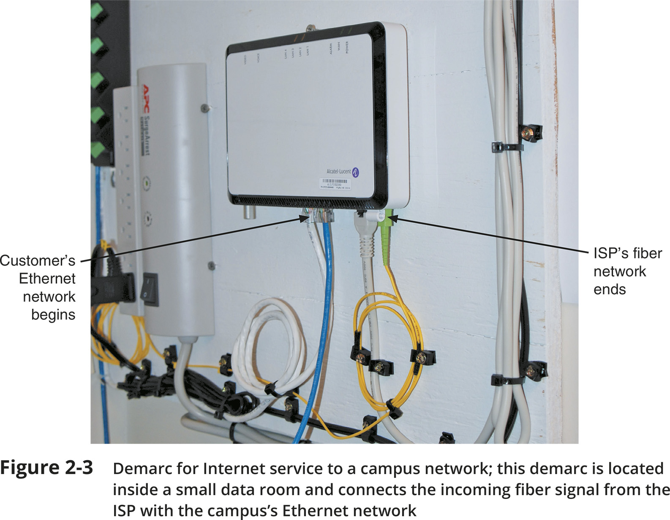
From the Demarc to a Workstation (4 of 11)

Slide 8
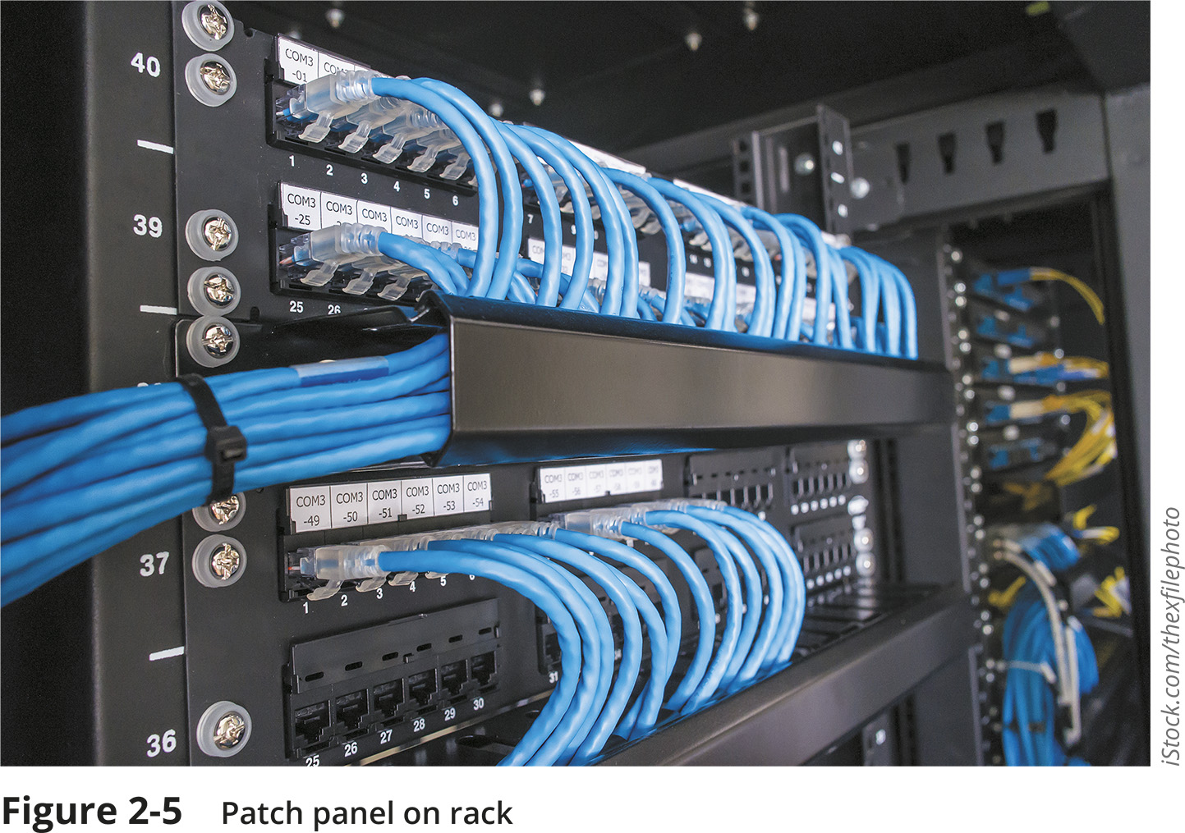
From the Demarc to a Workstation (5 of 11)

Slide 9
From the Demarc to a Workstation (6 of 11)
Entrance Facility in Building A (continued):
VoIP telephone equipment – VoIP (Voice over IP) is the use of any network to carry voice signals using TCP/IP protocols
In one or more data rooms you might find the following:
VoIP gateway
VoIP PBX
VoIP endpoints

Slide 10
From the Demarc to a Workstation (6 of 11)
Data Room in Building B:
IDF (intermediate distribution frame) – provides an intermediate connection between the MDF and end-user equipment on each floor and in each building
Work Areas in All Three Buildings:
Work area – encompasses workstations, printers, and other network devices
Wall jacks – the ANSI/TIA standard calls for each wall jack to contain at least one voice and one data outlet

Slide 11
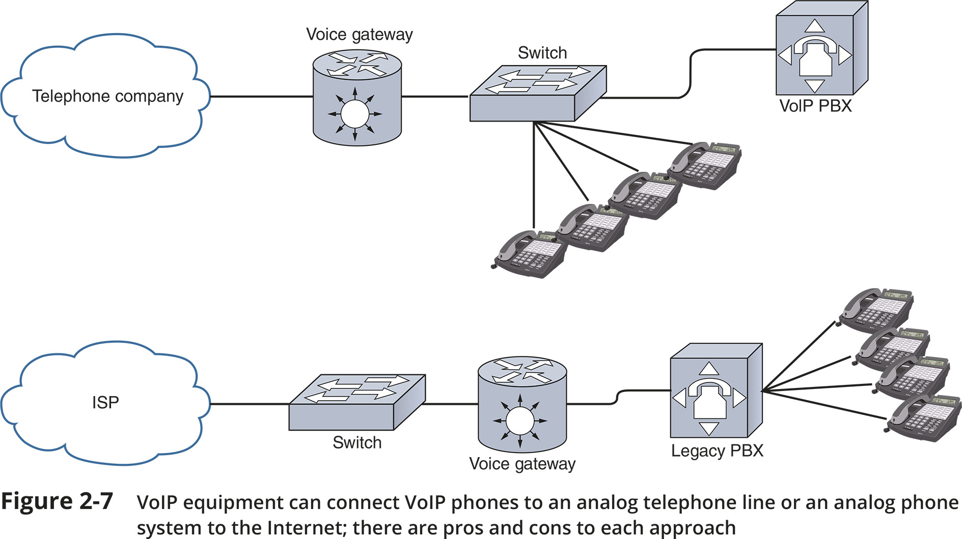
From the Demarc to a Workstation (7 of 11)

Slide 12
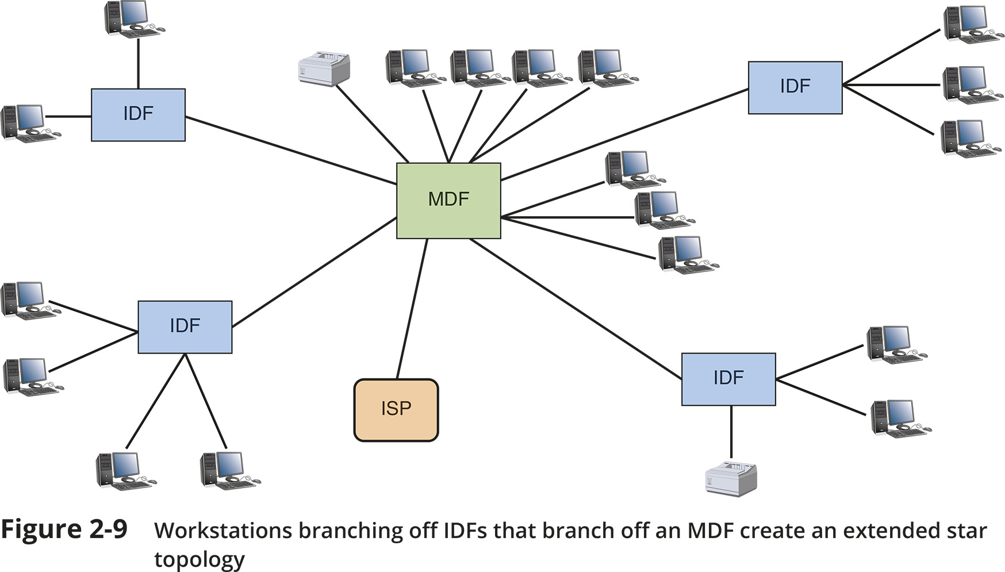
From the Demarc to a Workstation (8 of 11)

Slide 13
From the Demarc to a Workstation (9 of 11)
Rack Systems
Racks come in two-post and four-post varieties (though six-post racks are also available)
Racks may be wall- or ceiling-mounted, freestanding on the floor, or bolted to the floor
Consider the following when purchasing racks:
Height – rack height is measured in rack units (RU or U) with the industry standard being 42U tall
Width – equipment racks come in a standard 19-inch frame (19 inches wide)
Depth – rack depths vary between manufacturers
In data centres containing multiple rows of racks, a hot aisle/cold aisle layout pulls cool air from vents in the floor or from low-lying wall vents into rows of racks (see Figure 2-14)

Slide 14
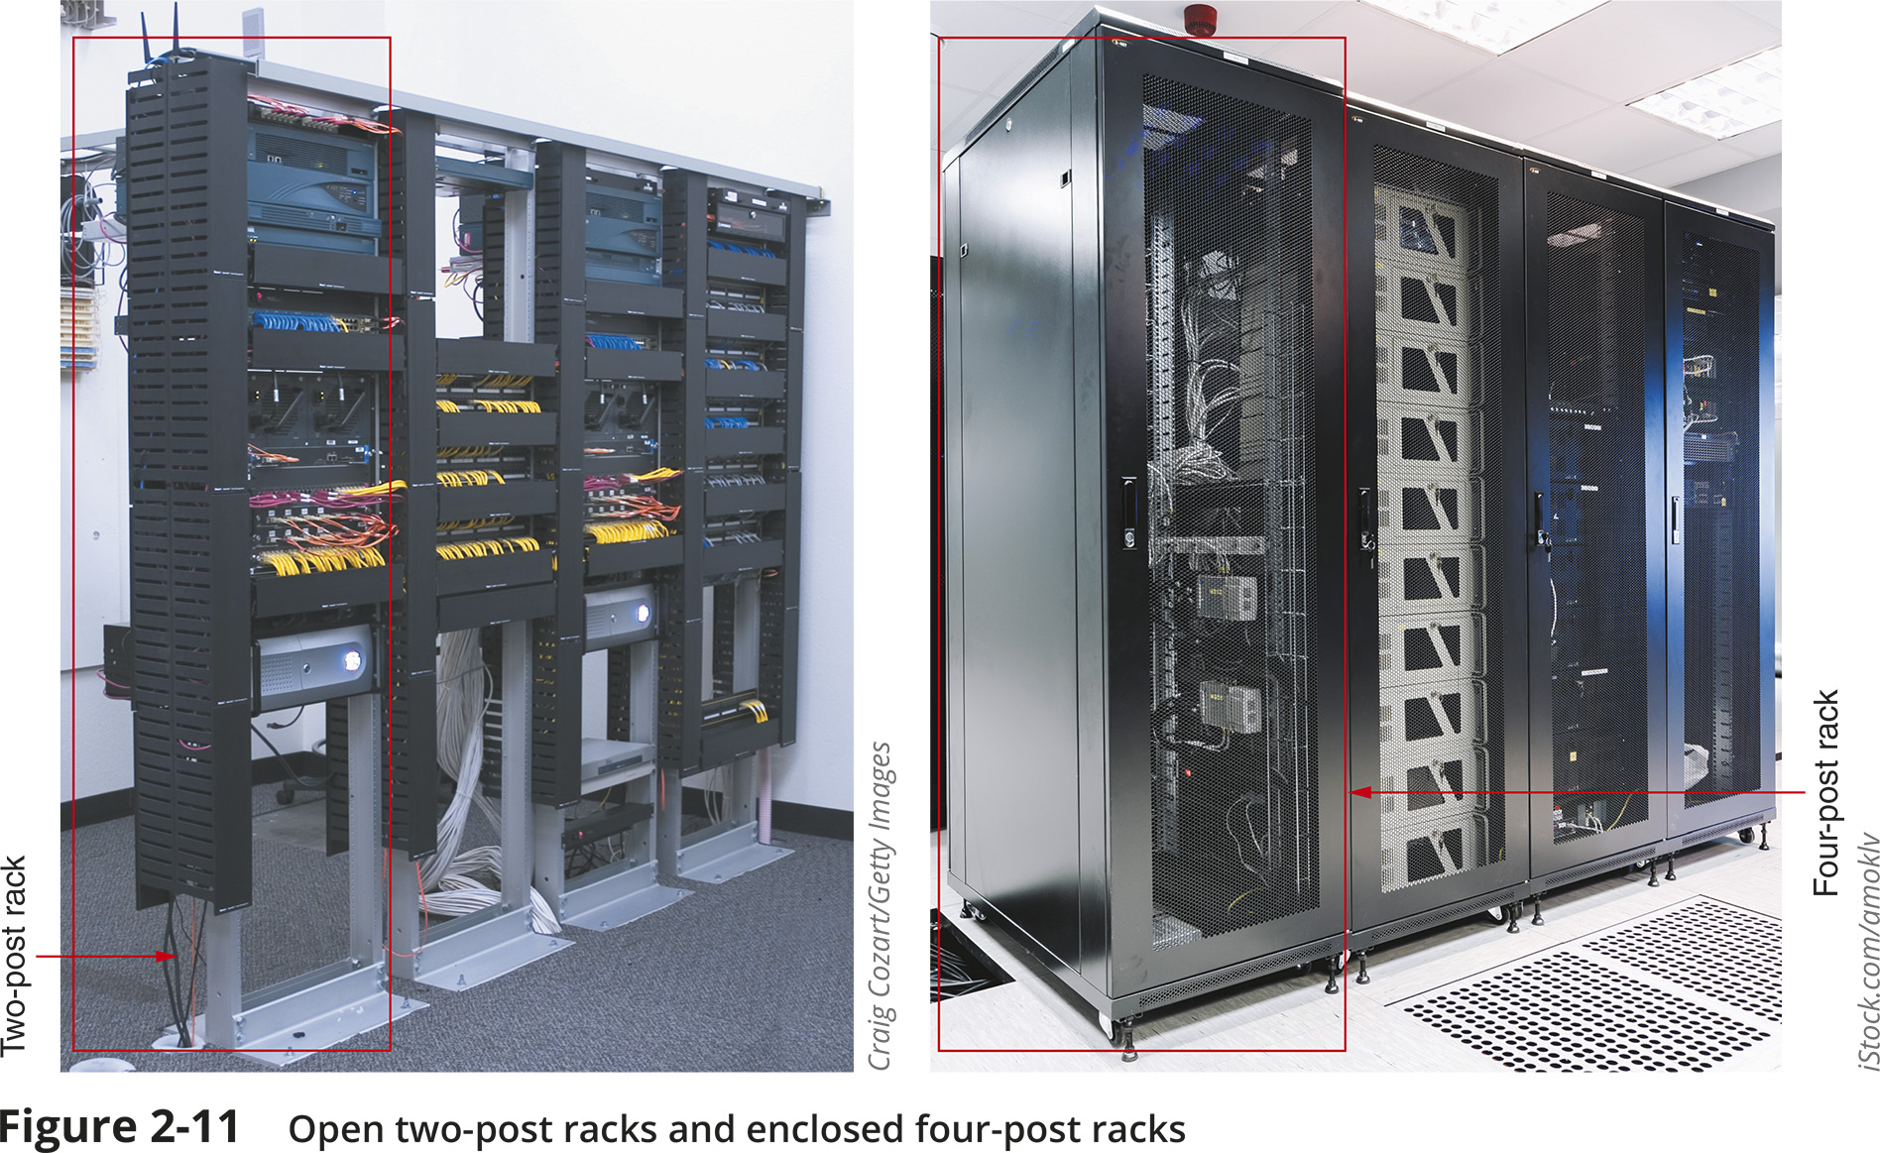
From the Demarc to a Workstation (10 of 11)

Slide 15
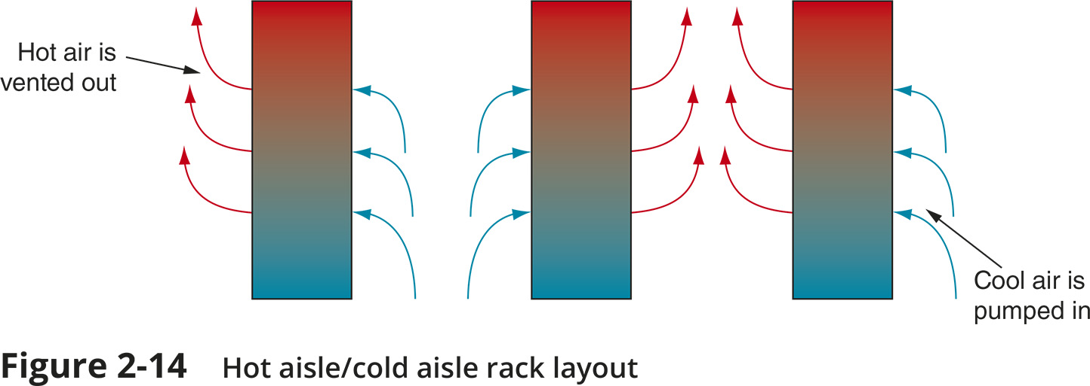
From the Demarc to a Workstation (11 of 11)

